Slide 1


Sree Vidyanikethan Engineering College
HEART DISEASE PREDICTION USING MACHINE LEARNING ALGORITHMS
Under the guidance of :
DR.M.Sunil Kuma
Professor
HOD of MCA
Submitted By:
BUSETTI SIVAIAH
Roll No:21121F0016

Slide 2
INDEX
ABSTRACT
INTRODUCTION
PROBLEM STATEMENT
LITERATURE SURVEY
PROPOSED MODEL
ALGORITHMS
1. INPUT
2. OUTPUT
DESIGN
RESULTS
CONCLUSION
FUTURE WORK
REFERENCE

Slide 3
ABSTRACT
Heart disease is a leading cause of mortality worldwide. Early and accurate prediction of heart disease can significantly improve patient outcomes by enabling timely intervention and appropriate treatment. According to world heath organization estimations almost 17 million people died in every year, it is 31% of total world deaths. In this model, we investigate the application of machine learning algorithms for the prediction of heart disease. We explore a comprehensive dataset consisting of patient information, including demographic factors, medical history, and clinical measurements. Various machine learning algorithms, including logistic regression, decision trees, random forests, support vector machines (SVM), and XGBoost, are employed to develop predictive model.it is a hybrid model. The dataset is preprocessed to handle missing values, normalize features, and address class imbalance.

Slide 4
INTRODUCTION
Heart disease is a significant public health issue and a leading cause of death worldwide. Early identification of individuals at high risk of developing heart disease is critical for effective prevention and management of the condition. Traditional risk factors such as age, gender, and family history have limited predictive power, and there is a need for more accurate and effective predictive models. Machine learning algorithms have shown great potential in the prediction of heart disease. These algorithms can analyze large amounts of data, including medical history, lifestyle habits, and clinical test results, to develop more accurate predictive models for identifying individuals at high risk of heart disease. The use of machine learning algorithms has the potential to improve patient outcomes by enabling healthcare providers to intervene earlier in the disease progression. However, the development of accurate machine learning models requires access to high-quality data, appropriate feature selection, and careful model training and validation. Additionally, the use of machine learning algorithms in healthcare raises ethical considerations around data privacy, bias, and transparency.

Slide 5
The heart decease is a leading cause of death worldwide, and the main problem is early identification of individuals at high risk is critical for effective prevention and management of the condition. Current methods for identifying individuals at risk of heart disease rely on traditional risk factors such as age, gender, and family history, which have limited predictive power.
PROBLEM STATEMENT

Slide 6
LITERATURE SURVEY
S. NO | Journal Type with year | Authors | Title | Outcomes
1 | Research Article 2018 | Amin Ul Haq, Jian Ping Li, Muhammad Hammad Memon, Shah Nazir, Ruinan Sun | A Hybrid Intelligent System Framework for the Prediction of Heart Disease Using Machine Learning Algorithms | This research study, a hybrid intelligent machine-learning-based predictive system was proposed for the diagnosis of heart disease.
2 | conference 2021 | Tsatsral Amarbayasgalan, Van-huy Pham Nipon Theera-umpon, Yongjun Piao And Keun Ho Ryu | An Efficient Prediction Method for Coronary Heart Disease Risk Based on Two Deep Neural Networks Trained on Well-Ordered Training Datasets | This study, we proposed the CHD risk prediction method based on two DNN models and applied it to the KNHANES dataset. The proposed method addressed preparing an efficient training dataset by distinguishing and enriching the highly biased subset that degrades the model performance using the PCA and VAE models.

Slide 7
3 | Journal 2021 | Dr. Joy Iong Zong Chen and P. Hengjind | Early Prediction of Coronary Artery Disease (CAD) by Machine Learning Method - A Comparative Study | The machine learning algorithm for early prediction procedure has discussed here. Thus our proposed algorithm has concluded that the overall performance of SVM is high to get accurate prediction results for CAD.
4 | Journal 2022 | Abdallah Abdellatif,hamdan Abdellatef,jeevan Kanesan,chee-onn Chow ,Joon Huang Chuah,and Hassan Muwafaq Gheni | An Effective Heart Disease Detection and Severity Level Classification Model Using Machine Learning and Hyperparameter Optimization Methods | This paper proposes an accurate and efficient decision support system based on the ML model to predict the absence or presence of CVD and classify the CVD’s severity level. The proposed model integrates SMOTE, ET, and HB.
5 | paper 2022 | Ghulab Nabi Ahmad, Shafiullah, Abdullah Algethami, Hira Fatima1 And Syed Md. Humayun Akhter | Comparative Study Of Optimum Medical Diagnosis Of Human Heart Disease Using Machine Learning Technique With And Without Sequential Feature Selection | This paper, a prediction strategy based on hybrid intelligent machine learning was developed to diagnose mortality during follow-up. Data from a database of heart disease clinical records were used to evaluate the approach.

Slide 8
PROPOSED SYSTEM
The proposed method for the prediction of heart disease using machine learning algorithms involves several steps is to collect relevant data on heart disease from different sources. The data should include information on risk factors such as age, gender, family history, cholesterol levels, blood pressure, as well as clinical indicators such as electrocardiogram (ECG) results and coronary calcium scan.
Advantages:
Increased Accuracy
Low latency

Slide 9
DIFFERENCES BETWEEN THE EXISTING SYSTEM AND THE PROPOSED SYSTEM
 | Existing System (Decision Tree) | Proposed System (LSTM with Attention-based Model)
Core Model | logistic regression, KNN, decision trees, and SVM | Hybrid model
Feature Engineering | Manual feature extraction | Automatic feature learning
Model Complexity | Less complex model | More complex model
Model Accuracy | Accuracy obtained 87% | Accuracy varying between 88% to 95%

Slide 10
ALGORITHMS
LOGISTIC REGRESSOR
Logistic regression is a popular statistical model used for binary classification. Despite its name, it is a regression algorithm that is commonly used for classification tasks. Logistic regression models the relationship between a set of input variables (features) and a binary target variable by estimating the probabilities of the target variable belonging to each class.
• Data Preparation
• Model Representation
• Training Process
• Estimating Probabilities
• Thresholding and Classification
• Regularization (optional)

Slide 11
SUPPORT VECTOR MACHINE(SVM)
SVM, which stands for Support Vector Machines, is a supervised machine learning algorithm used for classification and regression tasks. It is particularly effective in scenarios where the data is not linearly separable in the input feature space. SVMs aim to find an optimal hyperplane that maximally separates the data points of different classes.
Data Representation
Feature Transformation
Margin Maximization
Support Vectors
Non-linear Decision Boundaries
Optimization
Prediction

Slide 12
GRADIENT BOOSTING
Gradient Boosting is a machine learning algorithm that combines the predictions of multiple weak learners (typically decision trees) to create a strong predictive model. It works by iteratively training new models that focus on the errors made by previous models, gradually reducing the overall prediction error.
• Initialization
• Model Training
• Update the Weights
• Predict Ensemble Building
• Repeat Steps 2-4
• Final Prediction

Slide 13
XGBOOST
XGBoost (Extreme Gradient Boosting) is an optimized implementation of gradient boosting, which is an ensemble learning method that combines multiple weak models (typically decision trees) to create a strong predictive model. XGBoost is widely used in machine learning competitions and has gained popularity for its performance and scalability.
Regularization
Feature Importance
Handling Missing Values
Parallel Processing and Scalability
Cross-Validation
Tree Pruning
Tunable Hyper parameters

Slide 14
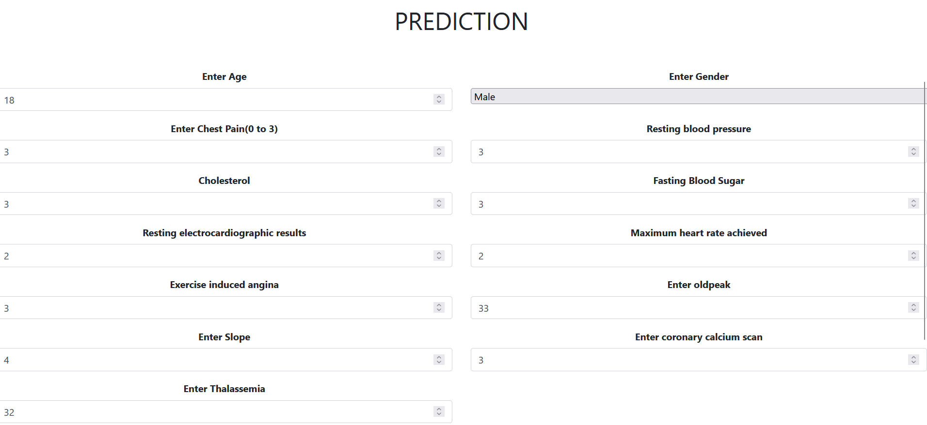
INPUT AND OUTPUT
Input: Here the user needs to provide data to the fields age, Gender, Chest Pain type, resting blood pressure, Cholesterol, Fasting blood sugar, electrocardiographic results, Maximum heart rate achieved, Exercise induced angina, oldpeak, Heart slope, coronary calcium scan and Thalassemia
Output: Based on the given input the model predict the person have heart disease or not.

Slide 15
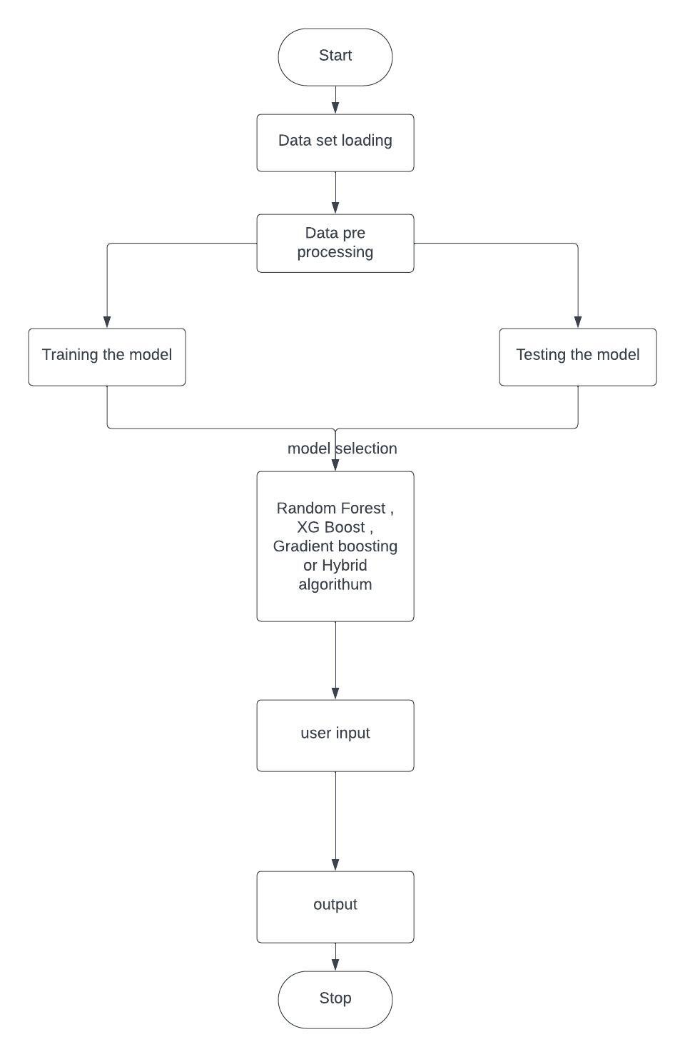
DESIGN
Flow chart

Slide 16
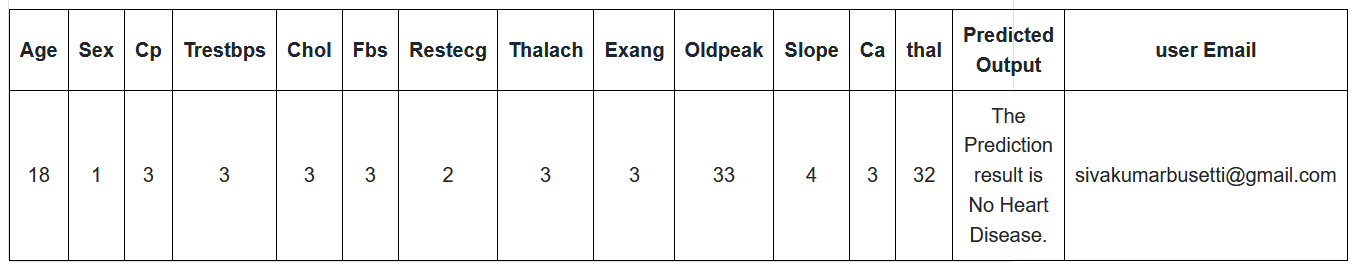
RESULTS

Slide 17
CONCLUSION
This model highlights the effectiveness of the hybrid machine learning algorithm in the prediction of heart disease. The combination of multiple algorithms and the incorporation of various risk factors enhance the accuracy and reliability of predictive model, potentially aiding in early detection and proactive management of heart disease.

Slide 18
FUTURE WORK
Future work in heart disease prediction systems can focus on addressing the limitations
and enhancing the effectiveness of the existing systems. Here are some potential areas for
improvement and future developments:
Integration of advanced technologies
Incorporation of additional risk factors
Integration with electronic health records (EHRs)

Slide 19
REFERENCES
[1] JIAN PING LI, AMIN UL HAQ, SALAH UD DIN, JALALUDDIN KHAN, ASIF KHAN, AND ABDUS SABOOR, "Heart Disease Identification Method Using Machine Learning Classification in E-Healthcare" and Digital Object Identifier 10.1109/ACCESS.2020.3001149
[2] PRONAB GHOSH, SAMI AZAM, MIRJAM JONKMAN, (Member, IEEE), ASIF KARIM, F. M. JAVED MEHEDI SHAMRAT, EVA IGNATIOUS, SHAHANA SHULTANA, ABHIJITH REDDY BEERAVOLU, AND FRISO DE BOER,” Efficient Prediction of Cardiovascular Disease Using Machine Learning Algorithms With Relief and LASSO Feature Selection Techniques” and Digital Object Identifier 10.1109/ACCESS.2021.3053759
[3] GHULAB NABI AHMAD, SHAFIULLAH, ABDULLAH ALGETHAMI, HIRA FATIMA, AND SYED MD. HUMAYUN AKHTER, “Comparative Study of Optimum Medical Diagnosis of Human Heart Disease Using Machine Learning Technique With and Without Sequential Feature Selection” and Digital Object Identifier 10.1109/ACCESS.2022.3153047
[4] GHULAB NABI AHMAD, HIRA FATIMA1, SHAFIULLAH, ABDELAZIZ SALAH SAIDI, (Member, IEEE), AND IMDADULLAH, (Senior Member, IEEE), “Efficient Medical Diagnosis of Human Heart Diseases Using Machine Learning Techniques With and Without GridSearchCV” and Digital Object Identifier 10.1109/ACCESS.2022.3165792
[5]WORLD HEALTH ORGANIZATION https://www.who.int/india/health-topics/cardiovascular-diseases
[6] UCI machine learning repository, Heart Disease and https://archive.ics.uci.edu/dataset/45/heart+disease
[7] amayomode repository, HEART DISEASE PREDICTION USING MACHINE LEARNI and https://github.com/amayomode/Heart-Disease-Risk-Prediction

Slide 20

THANK YOU

